Slide 1
DJango

Slide 2
Python
Python can be used to develop applications for frontend, backend, web scraping, scripting, cloud environments, AI, ML, data science, generative AI, Agentic AI, and AI agents.
Where we are not using:
Python is not commonly used for developing mobile applications.
But there is a Kivy framework
Python │ ├── Frontend (Limited) ├── Backend ├── Web Scraping ├── Automation / Scripting ├── Cloud ├── AI │ └── ML │ └── Data Science │ └── Gen AI │ └── Agentic AI

Slide 3
Basics
Web Application - The applications which will provide services over the web are called web applications.
Eg: gmail.com, facebook.com
Every web application contains 2 main components
Front-End 2. Back-End
Front-End - It represents what user is seeing on the website
Ex: HTML, JS, CSS, JQuery and BootStrap, React JS, Angular JS
Back End: Backend is responsible to generate required response to the end user, which is displayed by the Front-End.
Back-End has 3 important components:
1) The Languages like Java,Python etc
2) The Framework like DJango,Pyramid,Flask etc
3) The Database like SQLite,Oralce,MySQL etc

Slide 4
Web Framework
A web framework is a collection of tools and libraries that help developers to build and maintain web applications. It's also known as a web application framework (WAF). -
Benefits of using a web framework
Saves time: Developers don't need to write everything from scratch
Makes development more efficient: Developers can reuse code and follow a consistent development approach
Examples of web frameworks
Django, Flask, FastAPI, Bottle, Pyramid
Data Science Frameworks – Pandas, Numpy
ML/AI – TensorFlow, PyTorch
GUI - Tkinter

Slide 5
Django?
DJango is a high-level, free and open source Python web framework that helps developers build web applications quickly and securely.
It provides:
Built-in admin panel Authentication system (login/logout) ORM (database handling without SQL) Security features (SQL Injection, CSRF – Cross Site Req. Forgery) MVT architecture Fast development
Initial Development:
2003: Adrian Holovaty and Simon Willison – for newspaper content management - Lowrence Journal-World
The Django was named in the memory of Guitarist Django Reinhardt
Official website: djangoproject.com

Slide 6
Key Features
Reusability – Promotes reusable code via it modular design – follows DRY (Don't Repeat Yourself) Principle.
Rapid Development – The framework emphasizes fast development with a “batteries-included” i.e., a product comes with all the parts it needs to function
Contains Object-Relational Mapping (ORM) - a programming technique that connects object-oriented programming language i.e., python objects to relational databases.

Slide 7
Key Features
Security – provides built-in protection mechanism – SAND Box, SQL Injection, CSRF…
Scalability: Designed to handle high- traffic sites and large applications
Versatility: Suitable for building everything from simple websites to complex enterprise solutions i.e., any kind of app we can develop.
The benefits of using Django for web development also include its Representational State Transfer (REST) - software applications to communicate with each other over the Internet using standard HTTP methods. Ex: Amazon – by using REST API methods front end applications pull the data.
Uses JSON
{ "id": 1, "name": “ABC", "branch": "IT" }

Slide 8
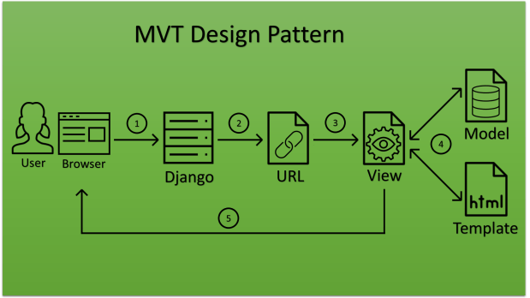
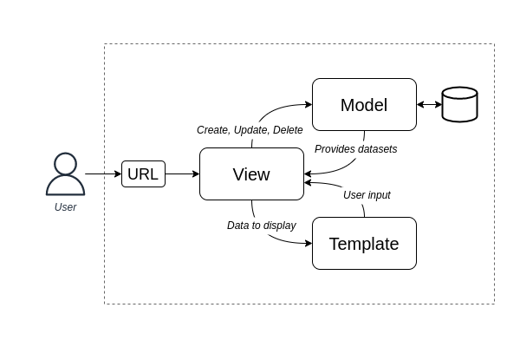
MVT Architecture
Model – Business Logic, for every table in a data base we will write class
Template – contains HTML code
View – Interacts and coordinates Model and template

Slide 9
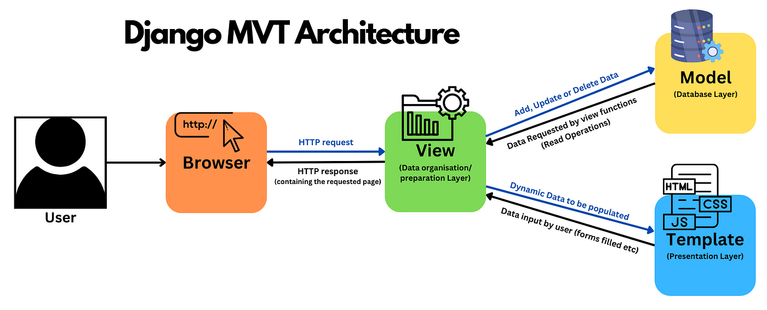
Step-by-step:
Client sends request
URL dispatcher calls the View
View processes logic
View sends data to Template
Template renders HTML
View returns HttpResponse to client
Client → URL → View → Model → View → Template → View → Client

Slide 10
Core Components
Models:
Defines database tables
Defines structure of data (fields and data types)
Represents data layer
Uses Django ORM (Object Relational Mapping)
Handles database interactions automatically
Templates:
Controls how data is presented to the user.
Template is HTML page
Displays data dynamically
Handles presentation layer only
Views:
Handles the logic of your application
Process the user request, interacts with models and returns response to the user by consulting with templates.

Slide 11
Create a Virtual environment
python –m venv verital_env_name
Go to scripts
activate

Slide 12
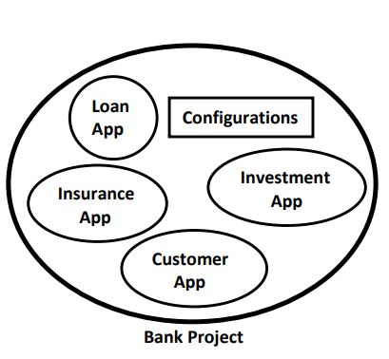
Django Project vs Django Application:
A Django project is a collection of applications and configurations which forms a full web application.
Bank Project
A Dango Application is responsible to perform a particular task.
loan app, registration app

Slide 13
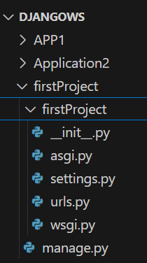
Creation of Django Project in VSC
django-admin start-project firstProject
Or python –m django start-project firstProject
The following structure will be created
__init__.py: It is a blank python script. Because of this special file name, Django treated this folder as python package.
settings.py: Database settings, Security settings, Application Settings
urls.py: Maps URL to view
wsgi.py: wsgi - > Web Server Gateway Interface.
Helps communicate with web servers like
Gunicorn
Apache HTTP Server
Used in production environment.
manage.py: Run development servers, Create apps, Apply migrations
Open Django shell
asgi.py : Used for asynchronous (The system can handle multiple tasks at the same time without waiting for one task to finish before starting another) support. It supports Real-time applications.

Slide 14
To run the server –
python manage.py runserver
Watching for file changes with StatReloader
Performing system checks...
System check identified no issues (0 silenced).
Run 'python manage.py migrate' to apply them.
March 07, 2025 - 07:18:25
Django version 5.1.7, using settings 'firstProject.settings'
Starting development server at http://127.0.0.1:8000/
Quit the server with CTRL-BREAK.

Slide 15
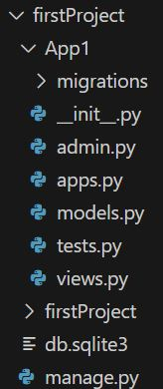
Creation of App in Project
python .\manage.py startapp App1
The following structure will be created
models.py - Defines database tables.
views.py - Handles business logic.
admin.py - Registers models for Django Admin panel.
tests.py - Used for testing.
migrations/ - Stores database change history.

Slide 16
Activities Required
Activity-1: Add our application in settings.py, so that Django aware about our application.
INSTALLED_APPS = [
'django.contrib.admin',
'django.contrib.auth',
'django.contrib.contenttypes',
'django.contrib.sessions',
'django.contrib.messages',
'django.contrib.staticfiles',
‘App1‘, ]
Settings.py

Slide 17
Activity 2: Create a view for our application in views.py.
View is responsible to prepare required response to the end user. i.e view contains business logic.
There are 2 types of views.
1) Function Based Views - As of now we are focusing on function based
2) Class Based Views
from django.shortcuts import render
from django.http import HttpResponse
def display(request):
return HttpResponse('<h1> Good Morning</h1>')

Slide 18
Activity-3: Define url-pattern for our view in urls.py file
This url-pattern will be used by end-user to send request for our views.
The 'urlpatterns' list routes URLs to views.
For functional views we have to do the following 2 activities:
1) Add an import: from App1 import views
2) path('GM/', views.display),
from django.contrib import admin
from django.urls import path
from App1 import views
urlpatterns = [
path('admin/', admin.site.urls),
path('GM/', views.display),
]

Slide 19
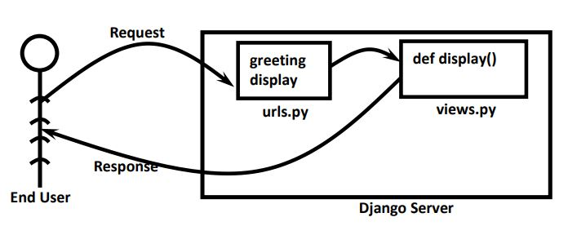
Activity 4: Start Server and Send the request
py manage.py runserver
http://127.0.0.1:8000/GM

Slide 20
Summary of Sequence of Activities related to Django Project:
Creation of Django project
django-admin startproject firstProject
Creation of Application in that project
py manage.py startapp App1
Add application to the Project (inside settings.py)
Define view function inside views.py
Define url-pattern for our view inside urls.py
Start Server
py manage.py runserver
Send the request

Slide 21
Tasks
Create a project to greet the user with different responses
GM - > good Morning
GA - > Good Afternoon
GE - > Good Evening
Single project with multiple applications
Create app to greet the user
Create app to return date and time
import datetime
time=datetime.datetime.now()
s='Hello Current Date and Time is :'+str(time)+'
return HttpResponse(s)
views.py

Slide 22
Basic Workflow
Create a Project
Use ‘django-admin startproject projectname’ to set up a new project.
If above one is not worked use python –m django startproject projectname
Create an App:
Use ‘python manage.py startapp appname’ to add new application(module such as dept, sales, purchases) to the project
Define Models:
Create models in ‘Models.py’ for database structure.
Create Views
Define views in ‘views.py’ to handle requests
Configure URLs:
Map URLs to views in ‘urls.py’
Create Templates:
Develop HTML templates for the front-end display
Admin Configuration
Register Models with the admin interface in ‘admin.py’

Slide 23
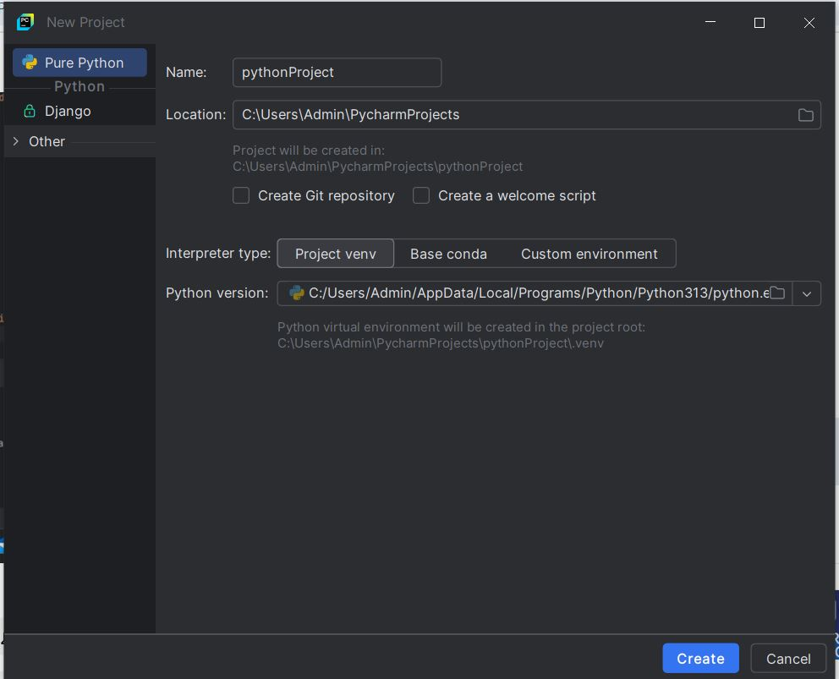
How to Create Project in Django - PyCharm
Using ATOM, PyCharm, VSC, and manually …
Using PyCharm – Bydefault Virtual environment will be added .
Download and Install PyCharm

Slide 24
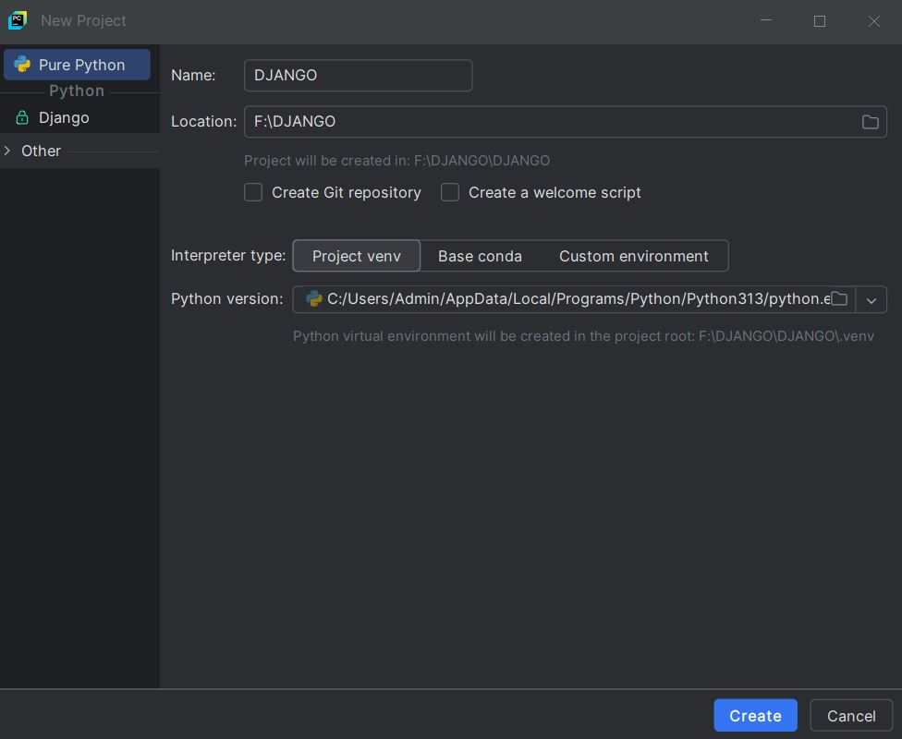
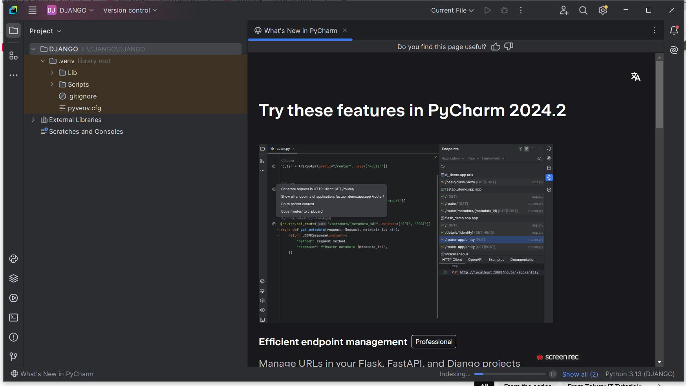

Slide 25
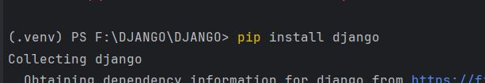
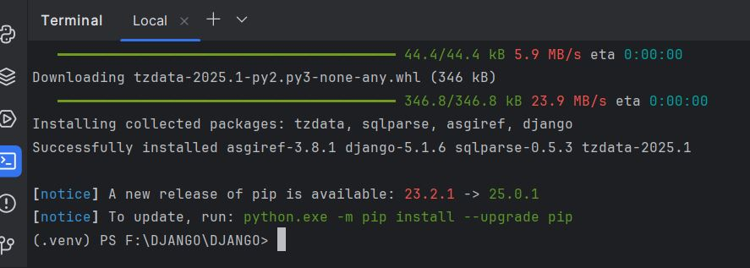
Next Install – Django
Go to terminal and type
pip install django

Slide 26
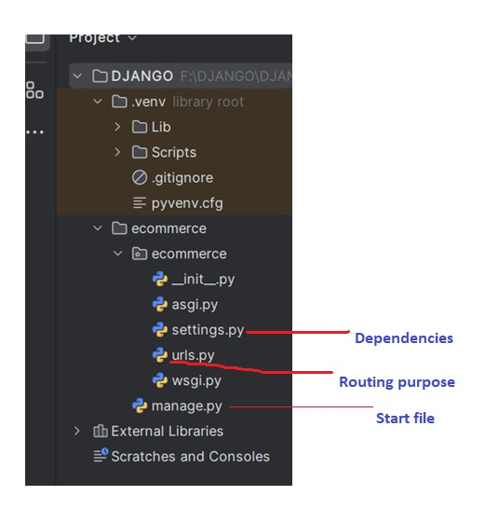
Next Create a Project
Type at terminal
django-admin startproject project_name
Ex: django-admin startproject ecommerce

Slide 27
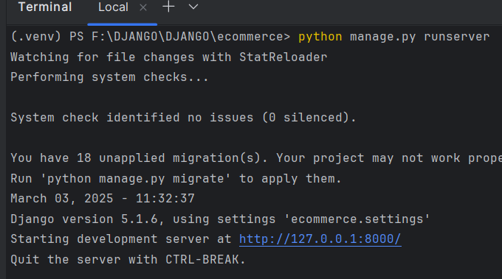
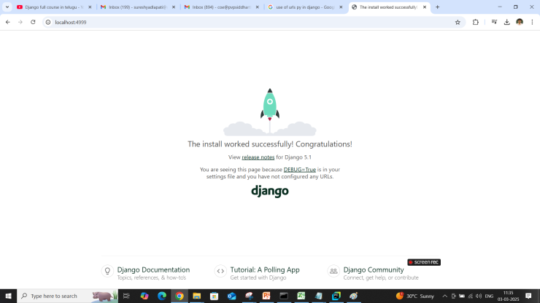
To run the project
Go to ecommerce
Type cd ecommerce at terminal
>cd ecommerce
Then type python manage.py runserver
If you want to change the port number
Type python manage.py runserver newportnumber at terminal

Slide 28
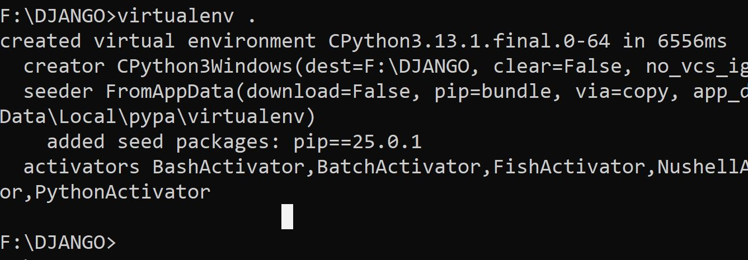
Using Command prompt
Create a directory in some location
F:\DJANGO>md Django_CMD
Install virtual environment
F:\DJANGO>pip install virtualenv
Then type virtualenv .
It creates root directory and some files

Slide 29
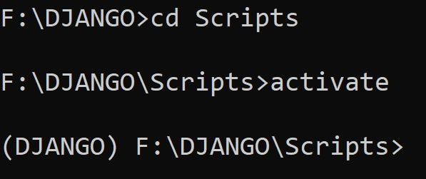
Using Command prompt
Goto scripts
F:\DJANGO>cd scripts
Type activate to make ready virtual environment
If we observer (DJANGO) will appear before cmd – now it is ready

Slide 30
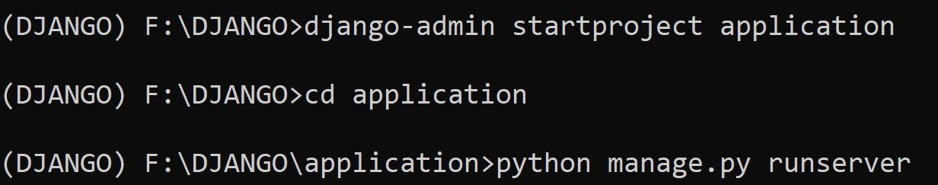
Using Command prompt
No type cd ..
Then type pip install django
(DJANGO) F:\DJANGO\Scripts>cd ..
(DJANGO) F:\DJANGO>pip install django
Now, Django is installed in that environment
Now, create project
django-admin startproject project_name
Ex: django-admin startproject application
To run the project
Go to newly created project and run the server

Slide 31
Using VS Code
Open VSC
Short cut instead of creating folder
Goto the folder (Ex: F:\DJANGO\DJANGO_USINGVSC) type cmd at addressbar
Then type code . at command prompt
Then go to terminal of VSC
Type python -m venv .
Now go to scripts (cd scripts)
Then add the activate the environment

Slide 32
Django Templates
It is not recommended to write html code inside python script (views.py file) because:
1) It reduces readability because Python code mixed with html code
2) No separation of roles. Python developer has to concentrate on both python code and HTML Code.
3) It does not promote reusability of code
We can overcome these problems by separating html code into a separate html file.
This html file is nothing but template. From the Python file (views.py file) we can use these templates based on our requirement.
We have to write templates at project level only once and we can use these in multiple applications

Slide 33
Steps to be followed:
Creation of Project
django-admin startproject templateProject or
Python –m django startproject name_of_the_project
Creation of Application
py manage.py startapp BasicTemplate
Add this application to the project in settings.py file,so that Django aware of application
Create a 'templates' folder inside main project folder. In that templates folder create a seperate folder named with BasicTemplateApp to hold that particular application specific templates.

Slide 34
Steps to be followed:
Add templates folder to settings.py file so that Django can aware of our templates.
TEMPLATES = [ { ..., 'DIRS': ['F:\DJANGOWS_YS\WorkingWithTemplates\\templates'],
},]
Create html file inside templates/BasicTemplateApp folder. This html file is nothing but template.
Define Function based view inside views.py file
from django.shortcuts import render
def wish(request):
render(request, 'BasicTemplateApp/TimeTable.html')
Define URL Pattern in urls.py
Run Server and send Request.

Slide 35
Template Tag
From Python views.py we can inject dynamic content to the template file by using template tags.
Template Tags also known as Template Variables.
In Django templates, we can render variables by putting them inside {{ }} brackets: {{var_name }}
In Django templates, we can perform programming logic like executing if statements and for loops.
These keywords, if and for, are called "template tags" in Django.
To execute template tags, we surround them in {% %} brackets.
{% if greeting == 1 %}
<h1>Hello</h1>
{% else %}
<h1>Bye</h1>
{% endif %}

Slide 36
ORM (Object Relational Mapping) – Creation of Emplyee Model (Table).
It allows you to use Python code instead of SQL queries. Django automatically converts ORM code into SQL.
from django.db import models
class Emp(models.Model):
name = models.CharField(max_length=100)
salary = models.FloatField()
department = models.CharField(max_length=50)
def __str__(self):
return self.name

Slide 37
ORM (Object Relational Mapping) Operations (CRUD)
Insert
Emp.objects.create(name=“Suresh", salary=50000, department="IT")
SQL - INSERT INTO emp (name, salary, department) VALUES (‘Suresh', 5000, 'IT');
Read
employees = Emp.objects.all()
it_employees = Emp.objects.filter(department="IT")
SQL - SELECT * FROM emp WHERE department='IT';
Update
emp = Emp.objects.get(id=1) emp.salary = 60000 emp.save()
SQL - UPDATE emp SET salary=60000 WHERE id=1;
Delete
emp = Emp.objects.get(id=1) emp.delete()
SQL - DELETE FROM emp WHERE id=1;

